Slide 1
NETFLIX MOVIES AND TV SHOWS CLUSTERING
Pranav Balpande
Kartik Dhande
Kartik Pisudde
Sanket Bhosale
Puja Nehare
Capstone Project-4

Slide 2
Content:
Introduction
Problem Statement
Data Description
Null Value
Exploratory Data Analysis
Data Cleaning
Topic modelling
Model Implementation
Data Pre-processing
Model Implementation
K- Means
Cluster Analysis

Slide 3

Introduction
Netflix is a company that manages a large collection of TV shows and movies, streaming it anytime via online. This business is profitable because users make a monthly payment to access the platform. However, customers
Netflix:
can cancel their subscriptions at any time.
Unsupervised Machine Learning (Clustering)
Methodology:
Netflix Movies and TV Shows
7787 rows and 12 columns
Data from last decade
Database:

Slide 4


Problem Statement
This dataset consists of tv shows and movies available on Netflix as of 2019. The dataset is collected from Flixable which is a third-party Netflix search engine.
In 2018, they released an interesting report which shows that the number of TV shows on Netflix has nearly tripled since 2010. The streaming service’s number of movies has decreased by more than 2,000 titles since 2010, while its number of TV shows has nearly tripled. It will be interesting to explore what all other insights can be obtained from the same dataset.
Integrating this dataset with other external datasets such as IMDB ratings, rotten tomatoes can also provide many interesting findings.
In this project, you are required to do
Exploratory Data Analysis
Understanding what type content is available in different countries
Is Netflix has increasingly focusing on TV rather than movies in recent years.
Clustering similar content by matching text-based features

Slide 5

Data Description
The data was collected from Flixable which is third party Netflix
search engine. The dataset consists of movies and TV shows data till
2019. The dataset has 7787 rows of data.
The dataset consists of eleven textual columns and one numeric
column.
Attribute Information :
show_id : Unique ID for every Movie / Tv Show
type : Identiﬁer - A Movie or TV Show
title : Title of the Movie / Tv Show
director : Director of the Movie

Slide 6
Data Description
5. cast : Actors involved in the movie / show
6. country : Country where the movie / show was produced
7. date_added : Date it was added on Netﬂix
8. release_year : Actual Release year of the movie / show
9. rating : TV Rating of the movie / show
10. duration : Total Duration - in minutes or number of seasons
11. listed_in : Genre
12. description: The Summary description

Slide 7
Null Value
Null Value Treatment:
● Director feature have more than 30.68% of null values. Filling null values by ‘unknown’.
● Country feature have 6.51% of null values. Filling null values by mode of feature.
● Cast feature have 9.22% of null values. Filling null values by ‘unknown’.
● Rating feature have 0.09% of null values. Filling null values by mode of feature.
● Date_added feature have 0.13% of null values. Dropping rows corresponding to null values.

Slide 8
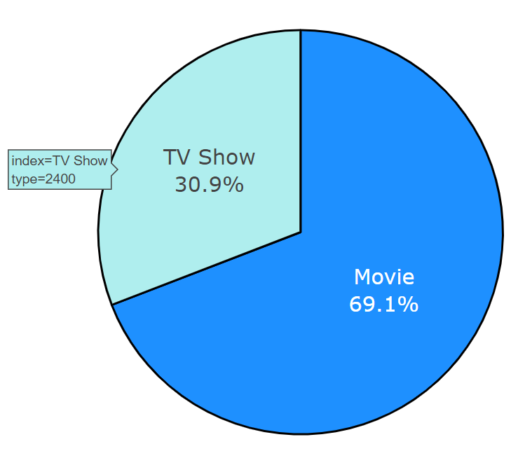
Exploratory Data Analysis
Type of content available on Netflix
•It is evident that there are more movies
on Netflix than TV shows.
•Netflix has 5377 movies, which is more
than double the quantity of TV shows.
index=Movie
type=5377

Slide 9
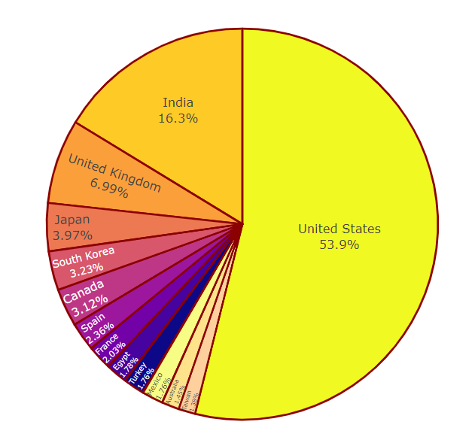
Exploratory Data Analysis
Top countries with highest content production
United States has the most number of
content on Netflix
India has second highest content
on Netflix
Australia and Taiwan has least number
of content on Netflix

Slide 10
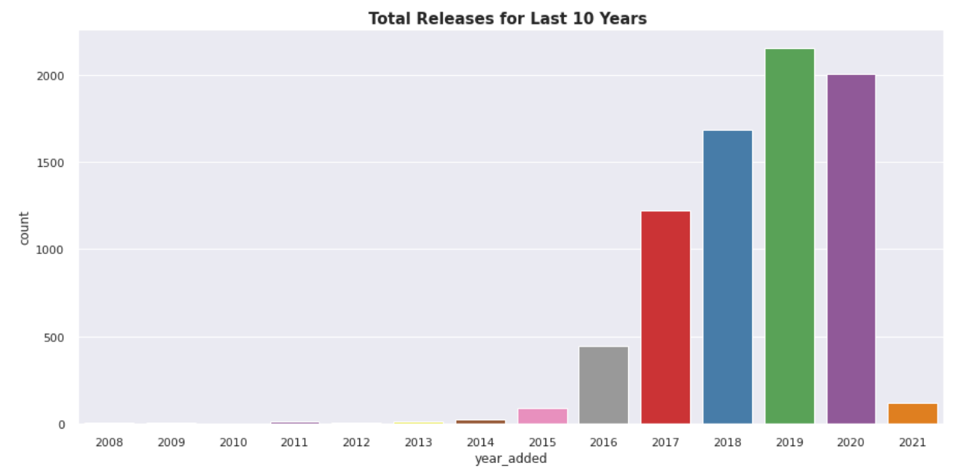
Exploratory Data Analysis
Releases over the year
The number of release have significantly increased after 2015 and have dropped in 2021
because of Covid 19

Slide 11
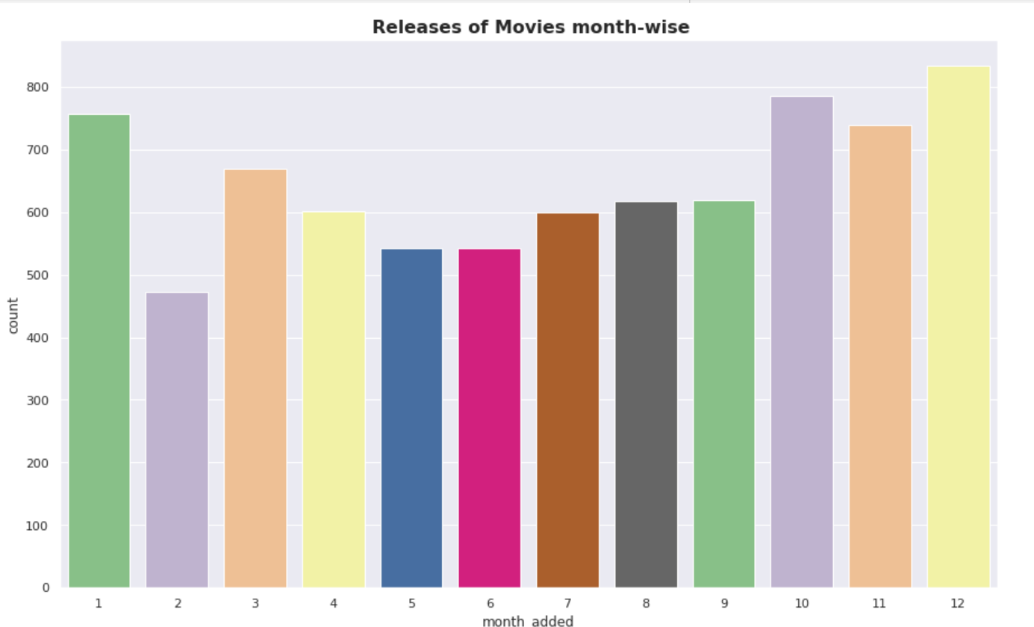
Exploratory Data Analysis

Slide 12
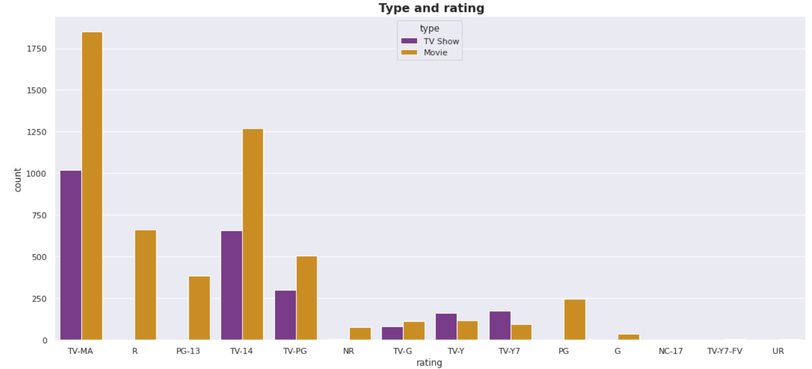
Exploratory Data Analysis
Rating wise content count

Slide 13
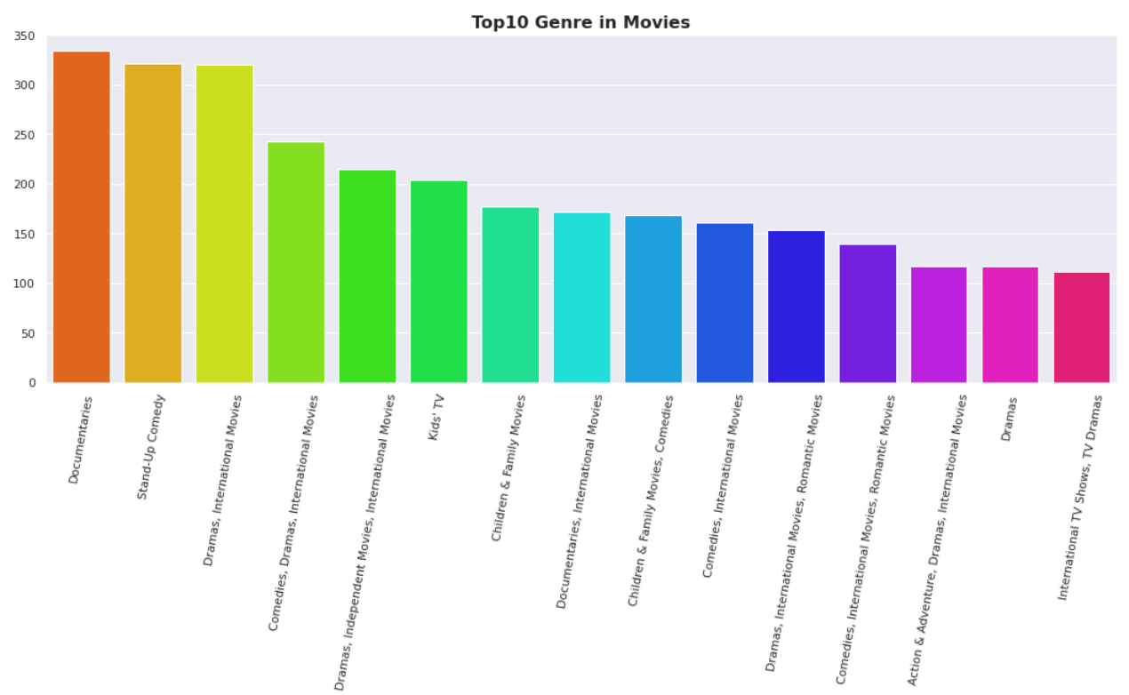
Exploratory Data Analysis
Documentaries is the most popular genre followed by comedy

Slide 14
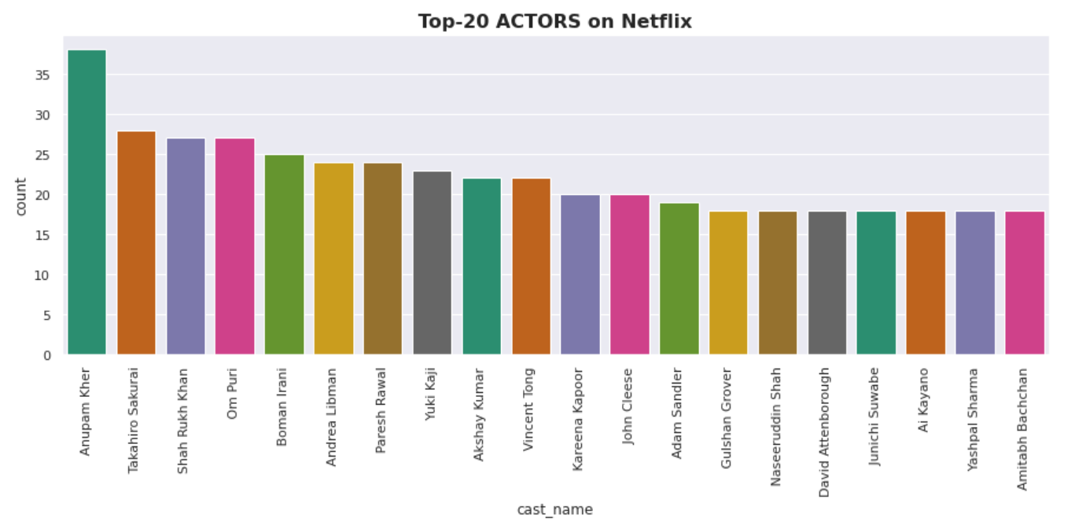
Exploratory Data Analysis

Slide 15
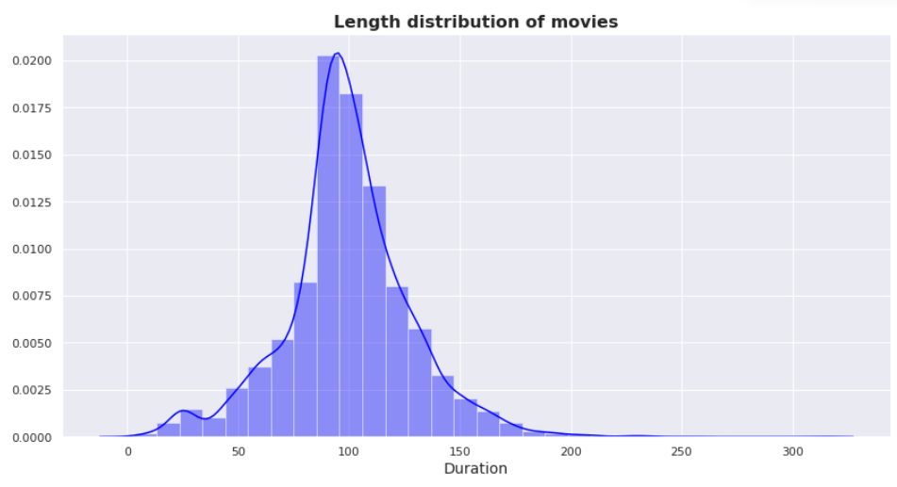
Duration distribution of Movies
Exploratory Data Analysis

Slide 16
Data Cleaning
Label Encoding
Lemmatisation- Lemmatization, unlike Stemming, reduces the inflected words properly ensuring that the root word belongs to the language. In Lemmatization root word is called Lemma. ... For example, runs, running, ran are all forms of the word run, therefore run is the lemma of all these words.
Removing Stop words - To remove stop words from a sentence, you can divide your text into words and then remove the word if it exits in the list of stop words provided by NLTK.
Tf - idf Vectorization - TF-IDF stands for “Term Frequency — Inverse Document Frequency”.
This is a technique to quantify a word in documents, we generally compute a weight to each word which signifies the importance of the word in the document and corpus. This method is a widely used technique in Information Retrieval and Text Mining.
Min-max Scaling - For each value in a feature, MinMaxScaler subtracts the minimum value in
the feature and then divides by the range. It preserves shape of original distribution.

Slide 17
Topic Modelling (LDA and LSA)
Latent Semantic Analysis(LSA) is used to find the hidden topics represented by the document or text. This hidden topics then are used for clustering the similar documents together. LSA is an unsupervised algorithm and hence we don't know the actual topic of the document.
● In natural language processing, the Latent Dirichlet Allocation (LDA) is a
generative statistical model that allows sets of observations to be explained
by unobserved groups that explain why some parts of the data are similar.

Slide 18
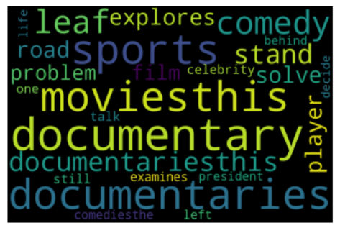
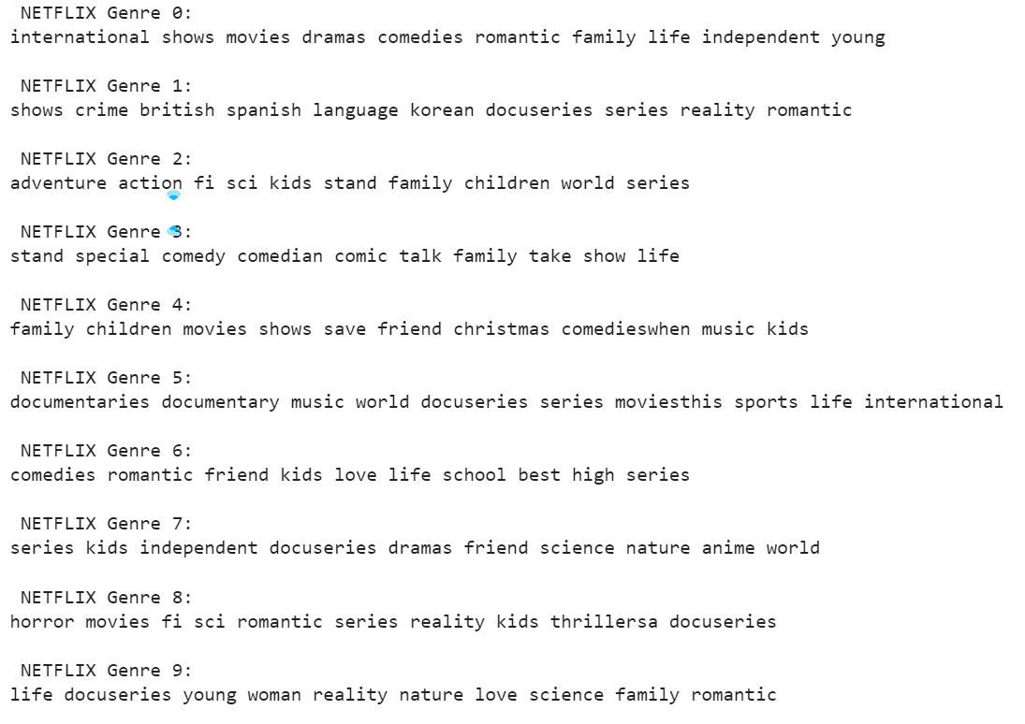
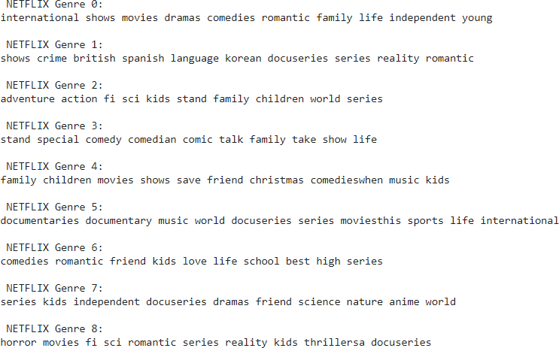
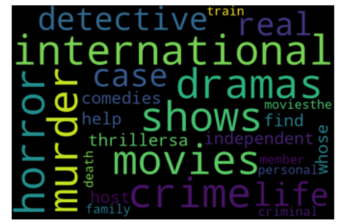
Topic Modelling (LDA and LSA)

Slide 19
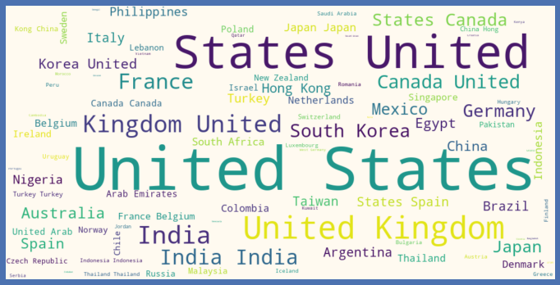
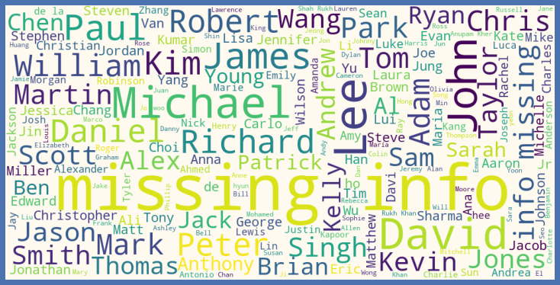
Word Cloud for Countries and Cast
Countries with the most content available
Which Cast to Choose?

Slide 20
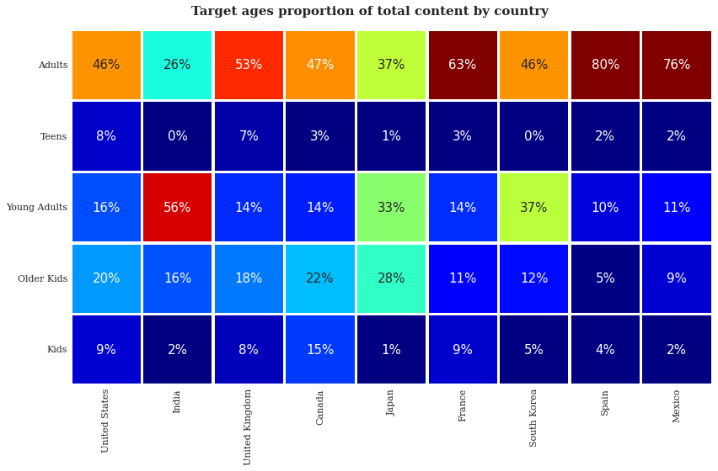
Correlation Heatmap

Slide 21
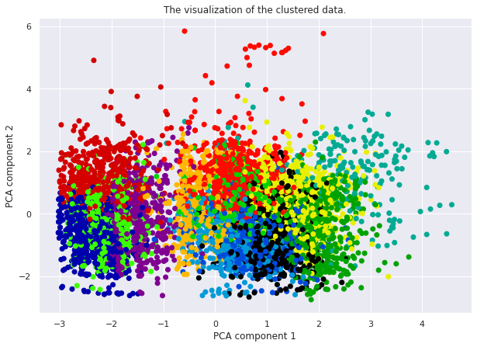
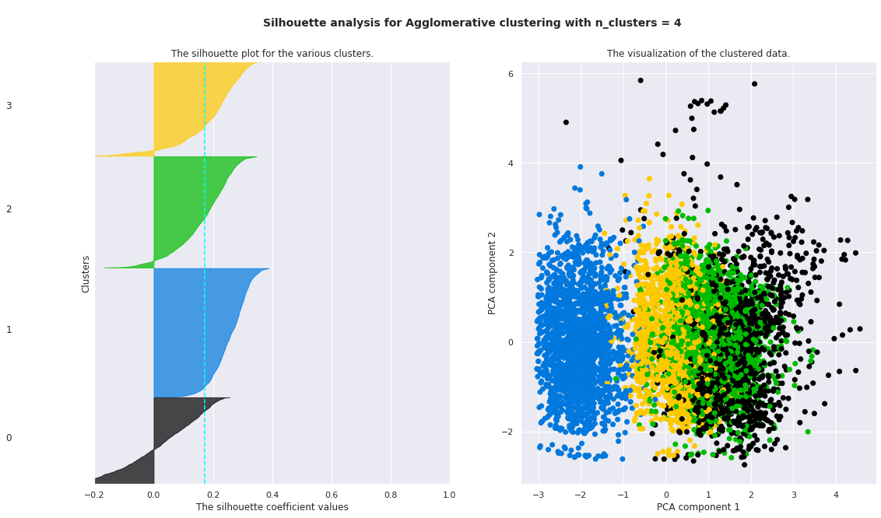
Model Implementation
1. Aﬃnity Propagation
2. Agglomerative Propagation
Converged after 81 iterations.
Estimated number of clusters: 13
Silhouette Coefficient: 0.244
Assume we cut vertical lines with a horizontal line to obtain the number of clusters. Number of clusters = 4
The average silhouette_score is : 0.17296314851287742

Slide 22
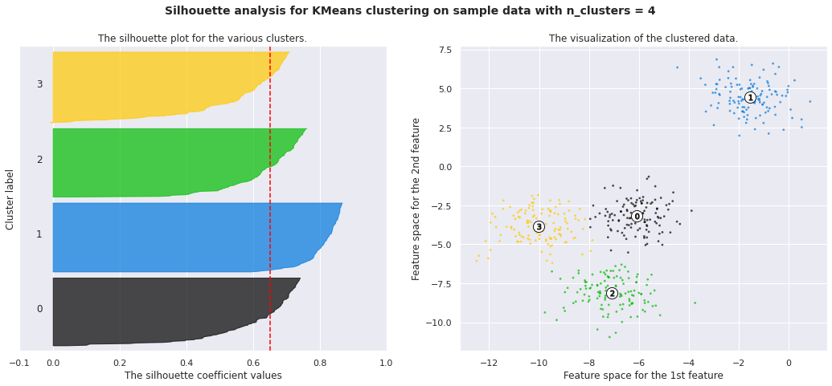
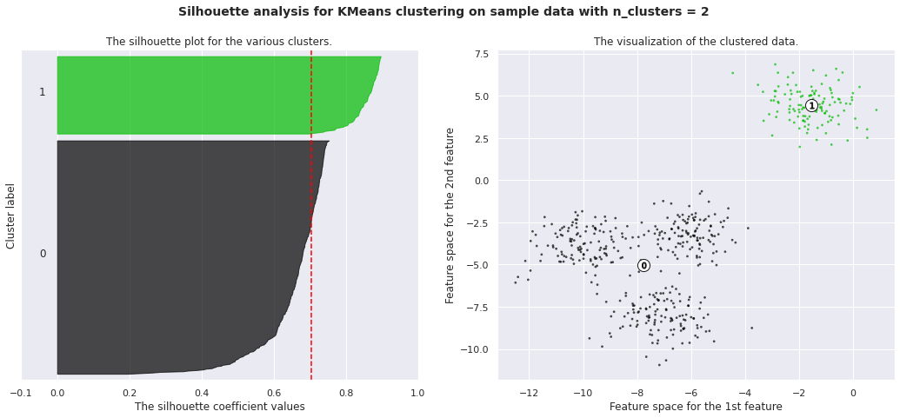
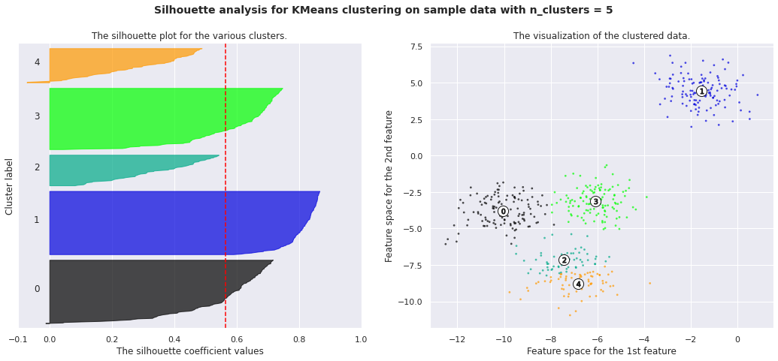
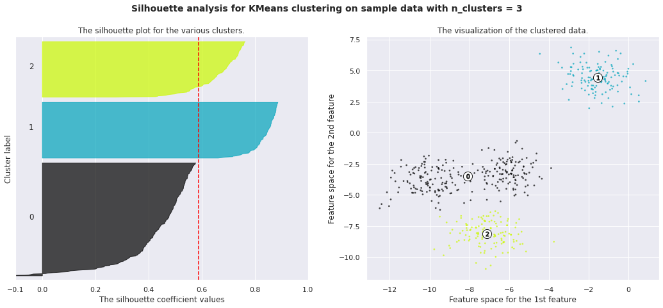
Model Implementation
3. k-means clustering

Slide 23
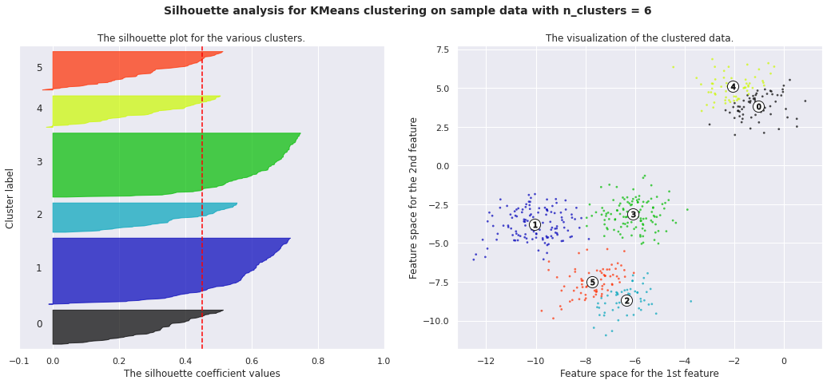
Model Implementation
3. k-means clustering
Here is the Silhouette analysis done on the above plots to select an optimal value for n_clusters.
The value of 4 and 5 for n_clusters looks to be the optimal one. The silhouette score for each cluster is above average silhouette scores.
For n_clusters = 2 The average silhouette_score is : 0.7049787496083262
For n_clusters = 3 The average silhouette_score is : 0.5882004012129721
For n_clusters = 4 The average silhouette_score is : 0.6505186632729437
For n_clusters = 5 The average silhouette_score is : 0.56376469026194
For n_clusters = 6 The average silhouette_score is : 0.4504666294372765

Slide 24
K - Means
To process the learning data, the K-means algorithm in data mining starts with a first group of randomly selected centroids, which are used as the beginning points for every cluster, and then performs iterative (repetitive) calculations to optimize the positions of the centroids
It halts creating and optimizing clusters when either:
The centroids have stabilized — there is no change in their values because the clustering has been successful.
The defined number of iterations has been achieved

Slide 25
K-Means Clustering
K-means algorithm is an iterative algorithm that tries to partition the dataset into K pre defined distinct non overlapping subgroups where each data point belongs to only one group.
1. Elbow Curve:
● The Elbow Curve is one of the most popular methods to determine this optimal value of k.
● The elbow curve uses the sum of squared distance (SSE)to choose an ideal value of k based on the distance between the data points and their assigned clusters.
2. Silhouette score :
● Silhouette score is used to evaluate the quality of clusters created using clustering algorithms such as K Means in terms of how well samples are clustered with other samples that are similar to each other.

Slide 26
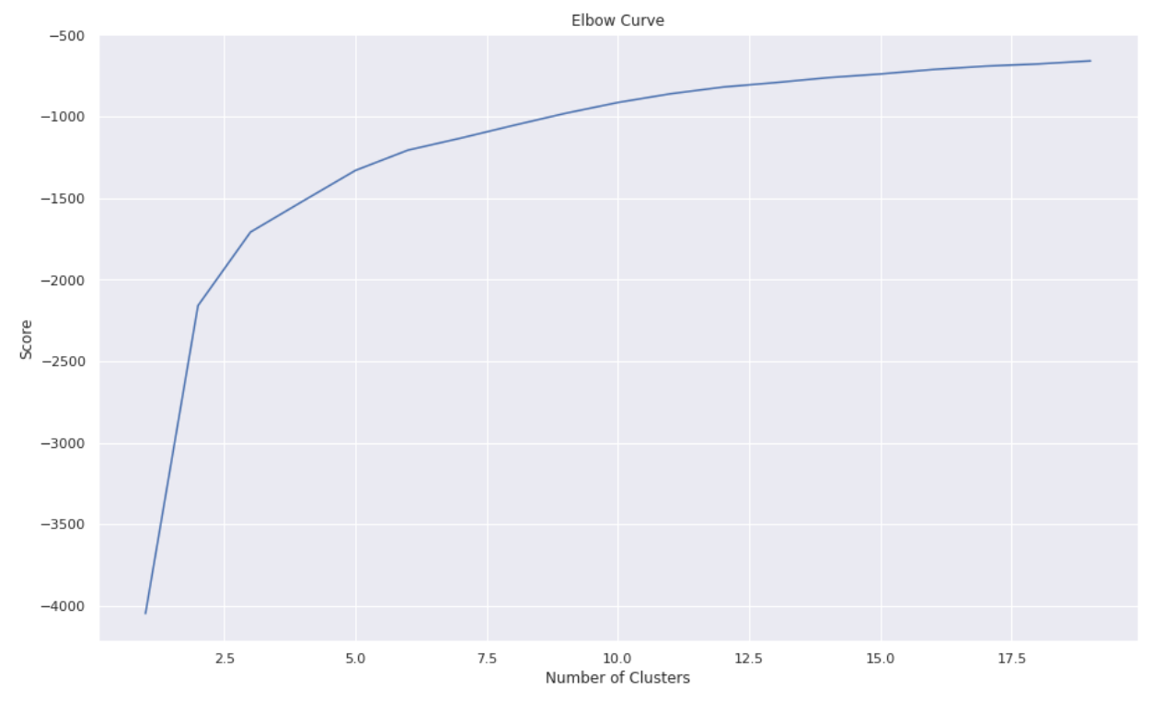
K-Means

Slide 27
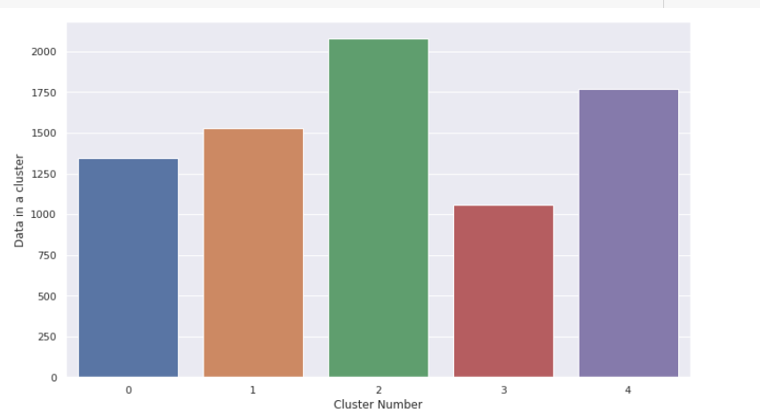
Clusters
We clearly see that one cluster is the largest and one cluster has the fewest number of movies.

Slide 28
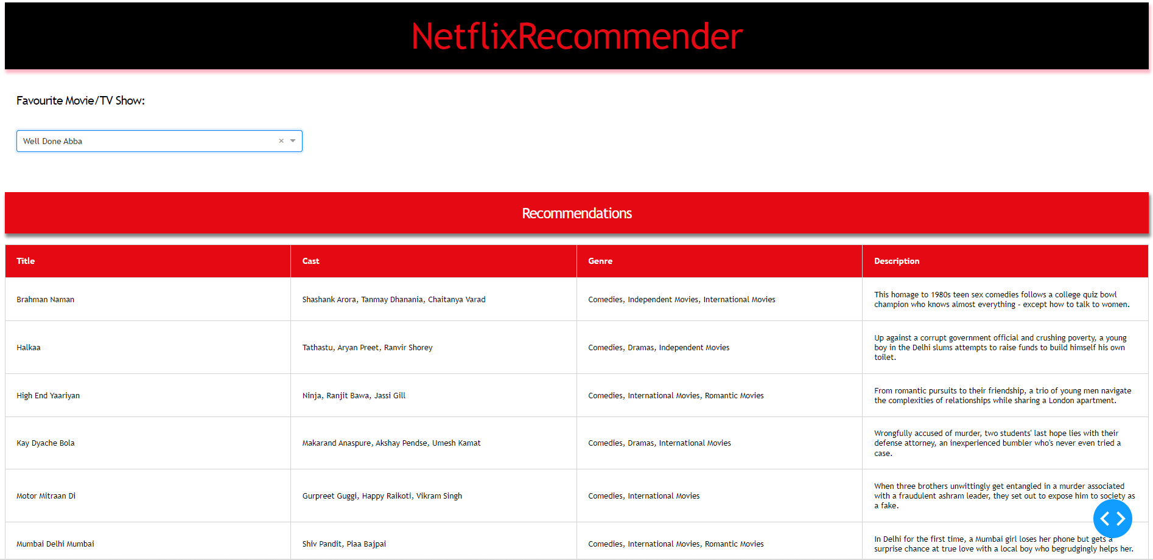
Run dashboard app

Slide 29

Conclusion
Data set contains 7787 rows and 12 columns in that cast and director features contains large number of missing values so we can drop it.
We have two types of content TV shows and Movies (30.9% contains TV shows and 69.1% contains Movies).
Most films were released in the years 2018, 2019, and 2020 and united states have the maximum content on Netflix.
The months of October, November, December and January had the largest number of films and Tv-shows released.
The USA, India, the United Kingdom, Canada, and Egypt are the top five producer countries.
For the clustering algorithm, we utilized type, director, nation, released year, genre, and year.
LDA and LSA has sorted much more similar titles in a group of genre.
Applied different clustering models Kmeans, hierarchical, Agglomerative clustering on data we got the best cluster arrangements.
In Affinity Propagation, we had 13 clusters and a Silhouette Coefficient score of 0.244.
We cut vertical lines with a horizontal line to obtain the number of clusters in Agglomerative Clustering. There were four clusters, with an average silhouette score of 0.17296314851287742.
The final model we used was k-means clustering, which consisted of 2,3,4,5,6 clusters. 4 numbers of clusters gives us good fitting.
After applying K - means optimal value of number of clusters is 5
Silhouette score for a set of sample data points is used to measure how dense and well-separated the clusters are.
.

Slide 30
Thank you

